Slide 1
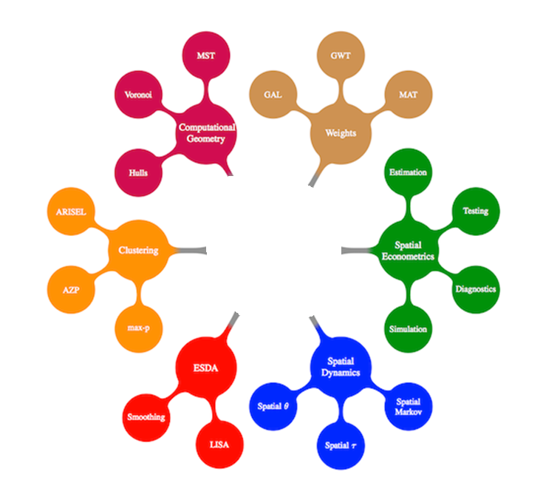

QGIS Plugin Development
Xing Kang, Yan-ting Liau,
Ngoc Nguyen Hong, Michael Palmer

Slide 2
Overview
What is QGIS?
What were our goals?
QT Framework
GUI Implementation
Methods Implemented
Weights Matrix Creation
ESDA – Moran’s I
Spatial Dynamics – Spatial Markov
QGIS PySal Plugin in Action!

Slide 3
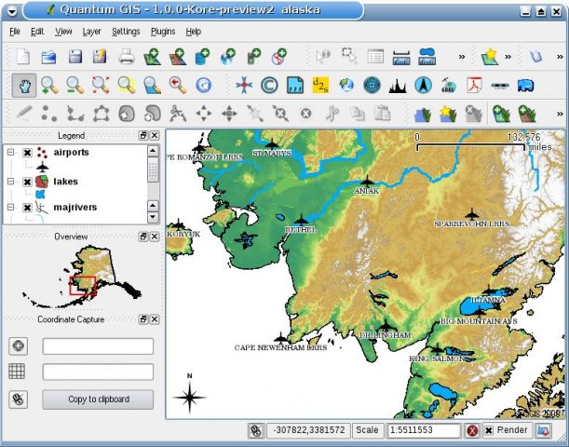
QGIS (Quantum GIS)
Open source GIS
Small lightweight
Easy to learn
GNU GPL License

Slide 4
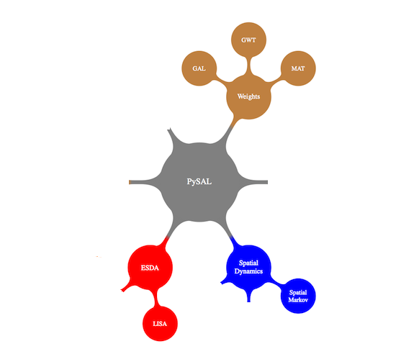
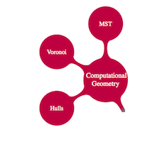
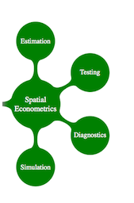
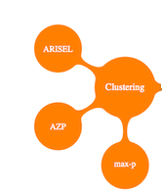



Goals: Pruning the PySal Tree

Slide 5
Why Use QT?
QGIS is written using QT Library
Why did they use QT?
Cross Platform
Widely used (Photoshop and Skype also use QT)
What we liked
Fast rough development with WYSISYG Editor
Fine tune the code afterwards

Slide 6
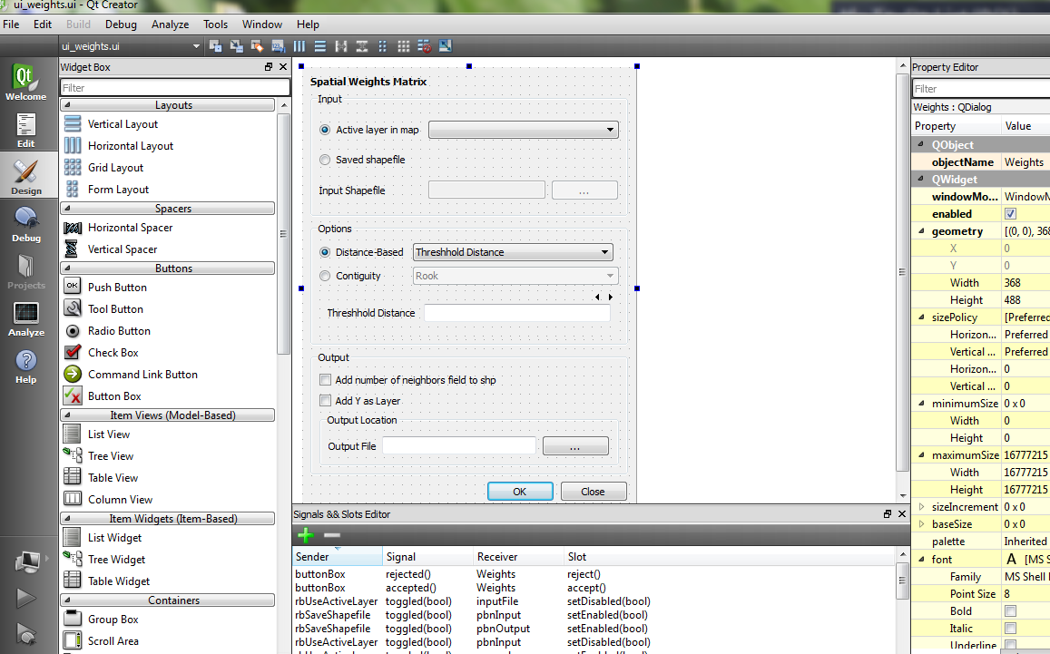
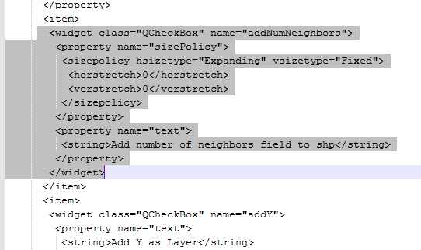

Slide 7
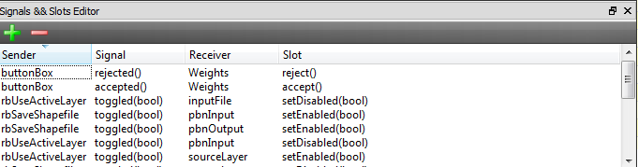
Signals in QT
User actions generate signals
use signals to change other widgets in the Editor
Handle signals with python functions
The function name
corresponds to the
specific signal
@pyqtSignature('int') #prevents actions being handled twice
def on_sourceLayer_currentIndexChanged(self,i):
l = self.layers[i]
self.lcount = l.featureCount()
self.ui.horizontalSlider.setMaximum(self.lcount-1)
self.ui.horizontalSlider.setTickInterval((self.lcount-1)/10 or 1)
select the layer with the index i
Use a method of Layer
Update a GUI Widget
Update a GUI Widget

Slide 8
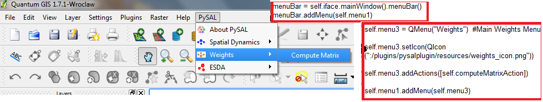
Design Decisions
Use the PySal splatter-chart to organize our plugin
PySal MenuBar.
Each Branch is a submenu.
Each Node is an Action in the submenu.

Slide 9
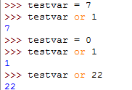

One quick python trick
Instead of adding another if statement
Python returns the last variable read for boolean logic.
Remember False = (0, “”, None) True = (all else)
.setTickInterval((self.lcount-1)/10 or 1)
use (self.lcount-1)/10 unless it equals 0 then use 1
Numbers
Strings

